Slide 1

Classification Analysis of Default Payment by
Credit Card Clients
By: Rucha Kadam

Slide 2
About the Dataset
The dataset consists of information on default payments.
If the payment was made on time or not, demographic factors: age, sex, marital information, credit card details, history of payment and bill statements: previous and current.
The dimensions of the dataset are 25 columns and 30000 rows.
This dataset was taken from Kaggle.

Slide 3
Research Questions:
Which variables are the strongest predictors of default payment?
How does the probability of default payment vary by categories of different demographic variables?

Slide 4
Classification Models:
Decision Tree
Random Forest
Ada Boost
Gradient Boost

Slide 5
Audience:
This analysis can be helpful for companies which give out credit cards or loans like banks and investment firms.

Slide 6
Data Preprocessing:
Education column labeled as category 0, category 5 and category 6 replaced with label 4 which is ‘other’ .
Marriage column replaced all the label 0 values with label 3, which according to description are others, where1 equals to married and 2 equals to single person.
The payment delay column replaced -1 and -2 with 0 and as the dues paid by the customer.
I have also created a feature importance function using .feature_importance_ function to create a table of columns and their respective scores.

Slide 7
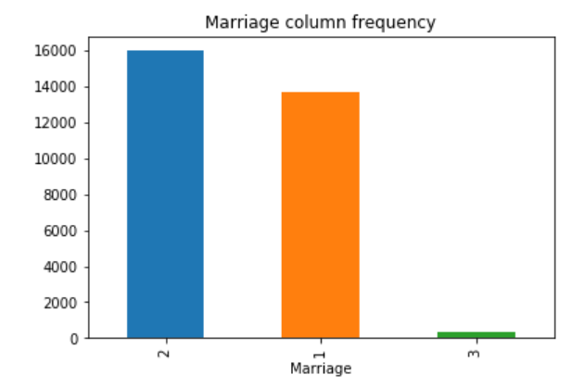
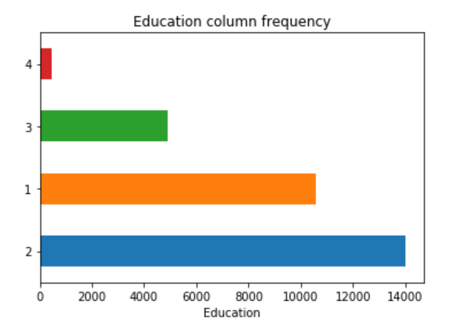
Descriptive Analysis

Slide 8
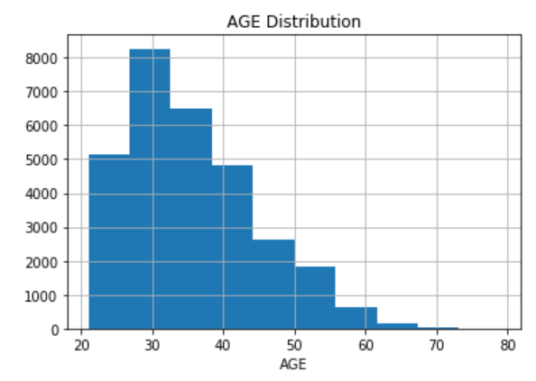
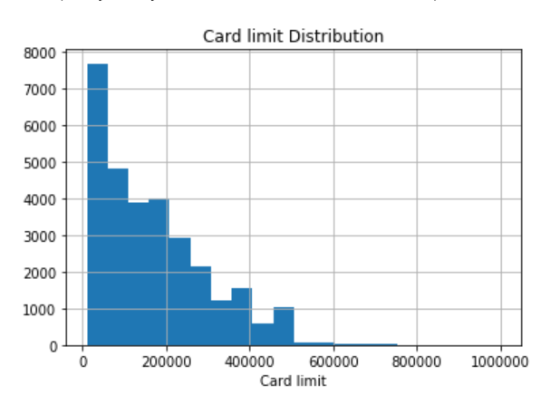
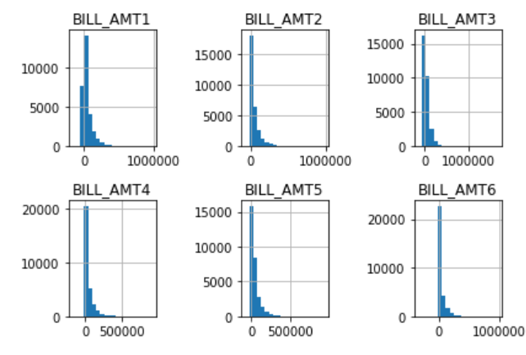
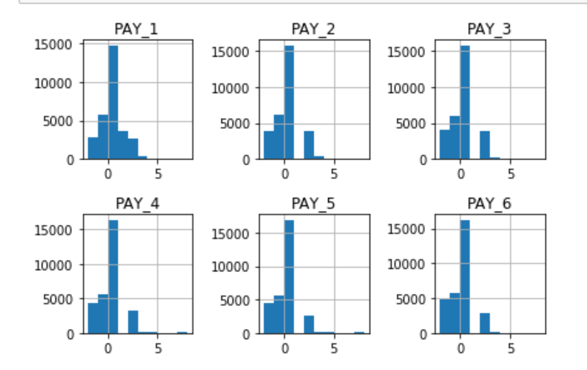

Slide 9
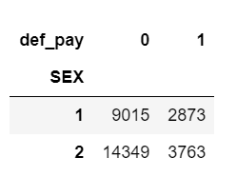
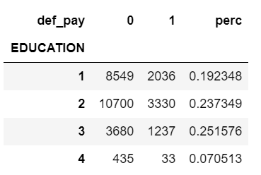
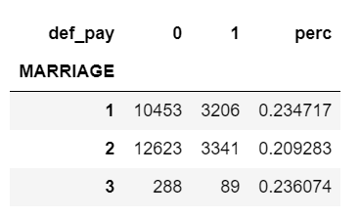
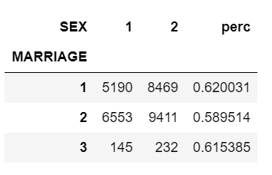
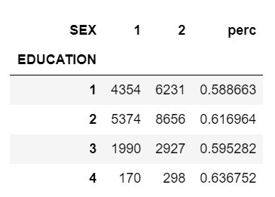
Finding Correlations

Slide 10
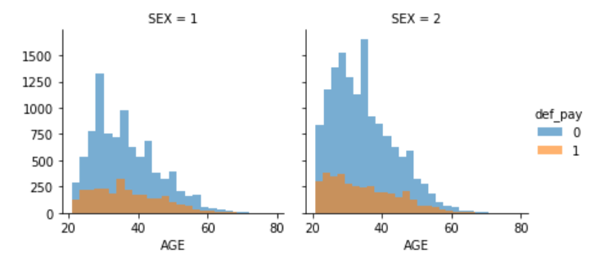
Finding Correlation

Slide 11
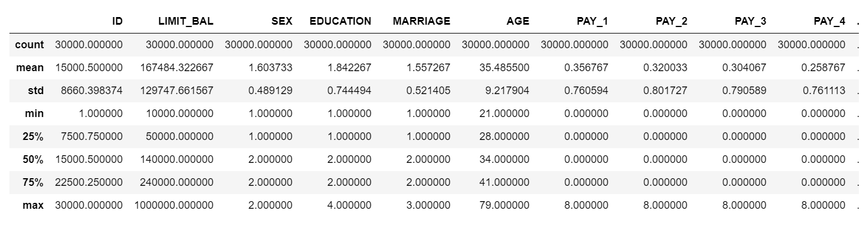
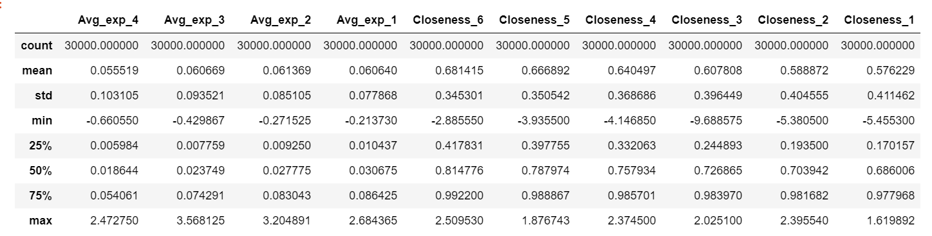
Data Summary

Slide 12
Parameters Used
Dependent variable: Def_Pay
Independent variables:

Slide 13
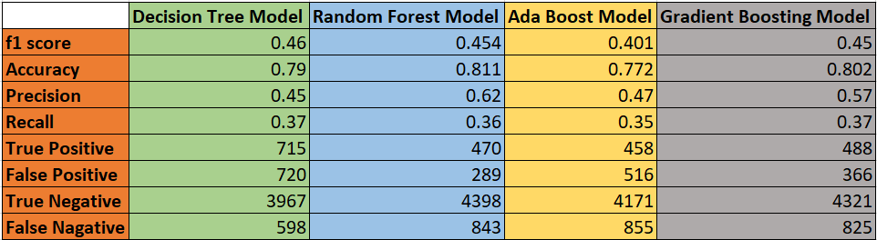
Classification Model Results

